Slide 1
Programming Basics
Ben Yetton

Slide 2
What is python
Python is a language, and a program
The python language is a set of rules (syntax) that represent computational instructions
The python app interpreters these instructions to make the computer do stuff
Python code is generally written in a text file (.py) and that file is then given to the python app to run
You need both an text editor (sublime) to write instructions and a console window (bash/terminal/cmd) to run the app
https://www.sublimetext.com/3

Slide 3
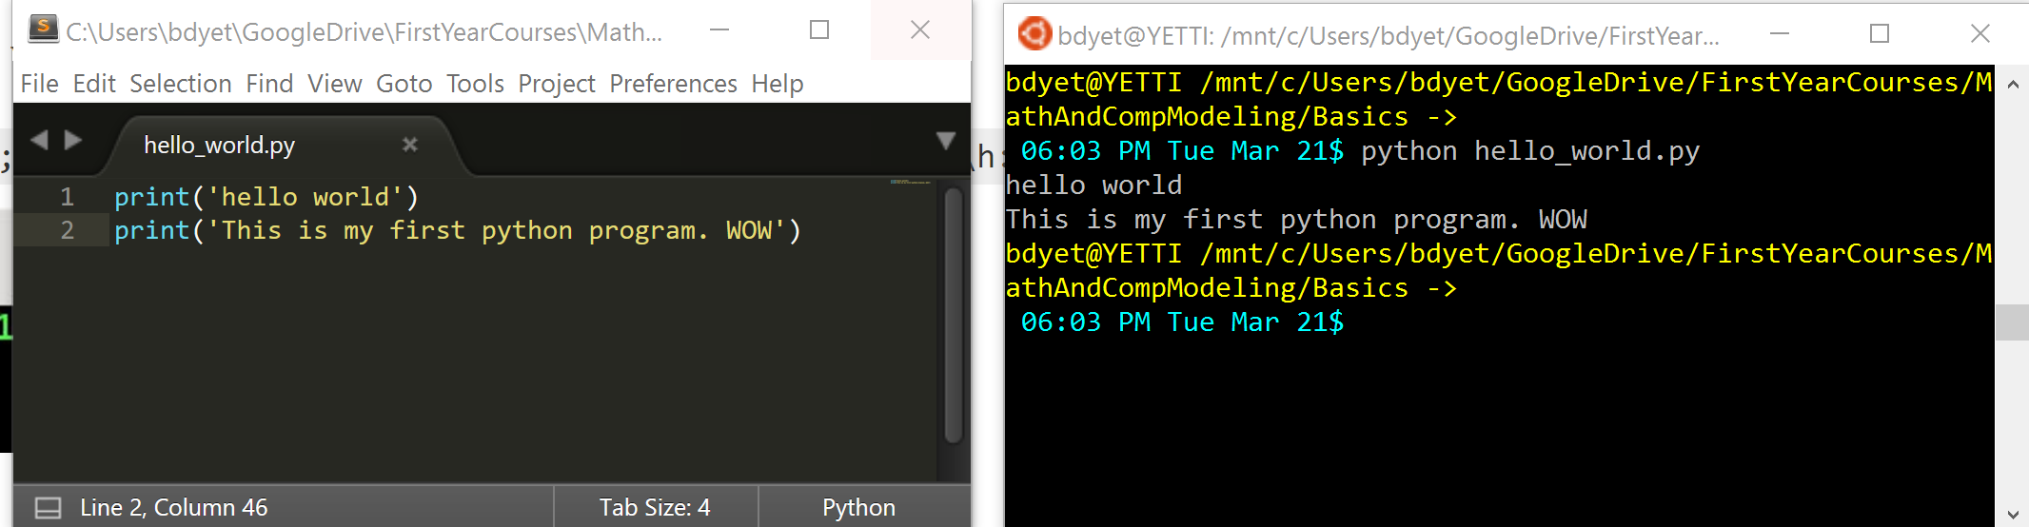
Text Editor (Sublime)
Console
Programs run line by line

Slide 4
Function “Print”
Input to function

Slide 5
Variables
A variable is a placeholder for some value
string_to_print = ‘Hi There’
print(string_to_print)

Slide 6
Variables can be different types
a_string_variable = ‘hi there’
a_char_variable = ‘h’
a_interger_variable = 3
a_float_variable = 3.1
a_char_variable = ‘3’
an_array_of_ints = [1,2,3]
an_array_of_chars = [‘1’,’2’,’3’]
Cardinal Programing Rules:
Don’t repeat yourself
readability>compact code
Descriptive and consistent variable/function names
No magic numbers

Slide 7
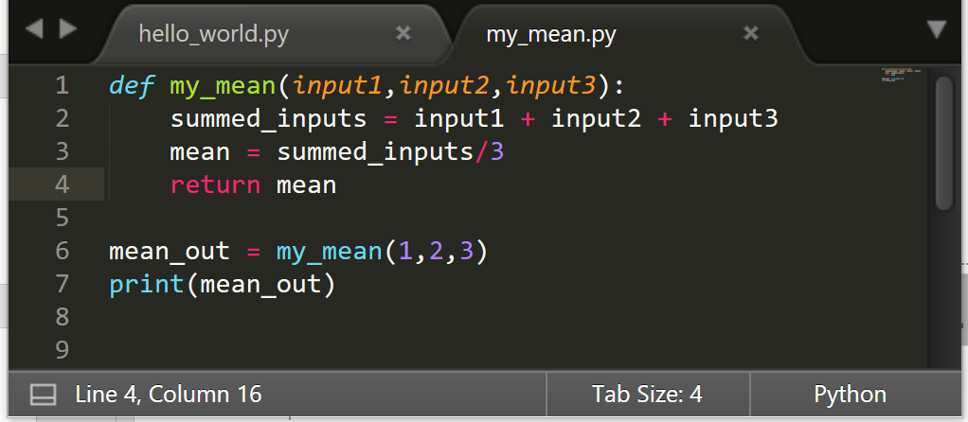
Functions again
Name of function
Inputs
Tells us this is a function
Return statement
Calling the function

Slide 8
Function scope
Scope in python is through indentation
Function Scope
Global Scope

Slide 9
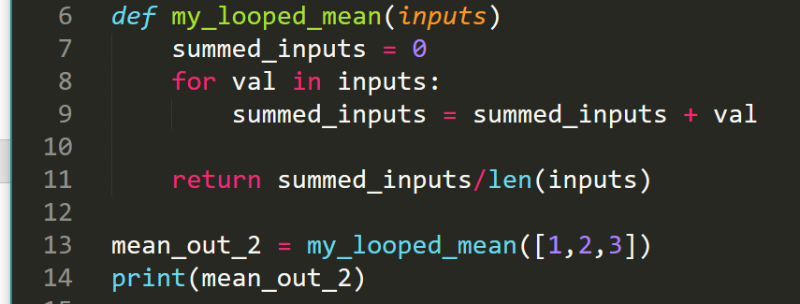
Loops!
Nesting

Slide 10
Cardinal Programing Rules:
Readability>compact code
Descriptive and consistent variable/function names
No magic numbers
Don’t repeat yourself

